Slide 1
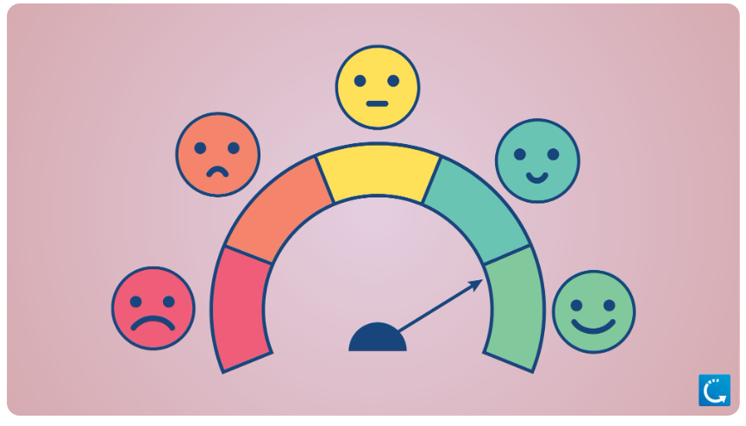
Mental Health Mood Tracker
Name : Vaishnavi Amit Ojha
Trainer Name : Khushi Barole

Slide 2

INDEX
Introduction
Problem Statement
Python Code
Implementation
Flow chart
Results & Output
Conclusion

Slide 3
—Introduction
• Mental health is a critical part of overall well-being.
• Self-awareness of mood can help improve mental resilience.
• This project is a simple Python-based Mood Tracker.
• It helps users log emotions and receive motivational advice
.
• Weekly summaries provide insights into emotional patterns.

Slide 4
—Problem Statement
• Individuals struggle to consistently track emotional health.
• Lack of awareness hinders mental wellness.
• A need exists for a user-friendly solution to:
            - Track moods daily
            - Provide motivational feedback
            - Reflect on weekly mood trends

Slide 5
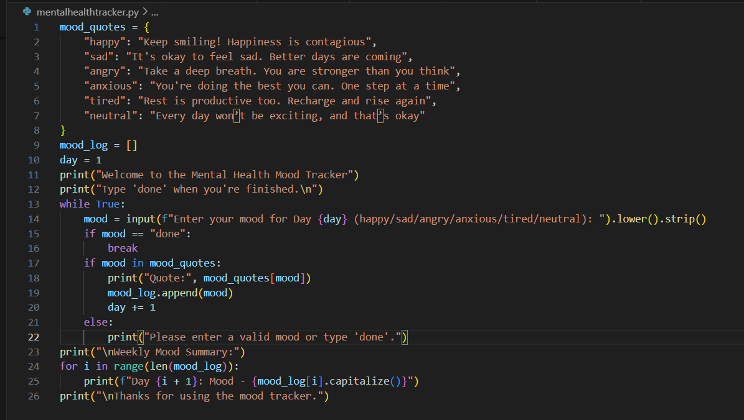
-Python Code
Python Features Used
input(), print()
      while and for loops
      if-elif-else conditions
      Dictionary, list, Counter
      String methods: lower(), strip(), capitalize()

Slide 6
-Implementation
Python script developed using:
    Input/Output for mood entry
    While loop for daily tracking
    Dictionary for motivational quotes
    If-elif-else for mood analysis
    For loop for weekly summary
    String methods for formatting

Slide 7
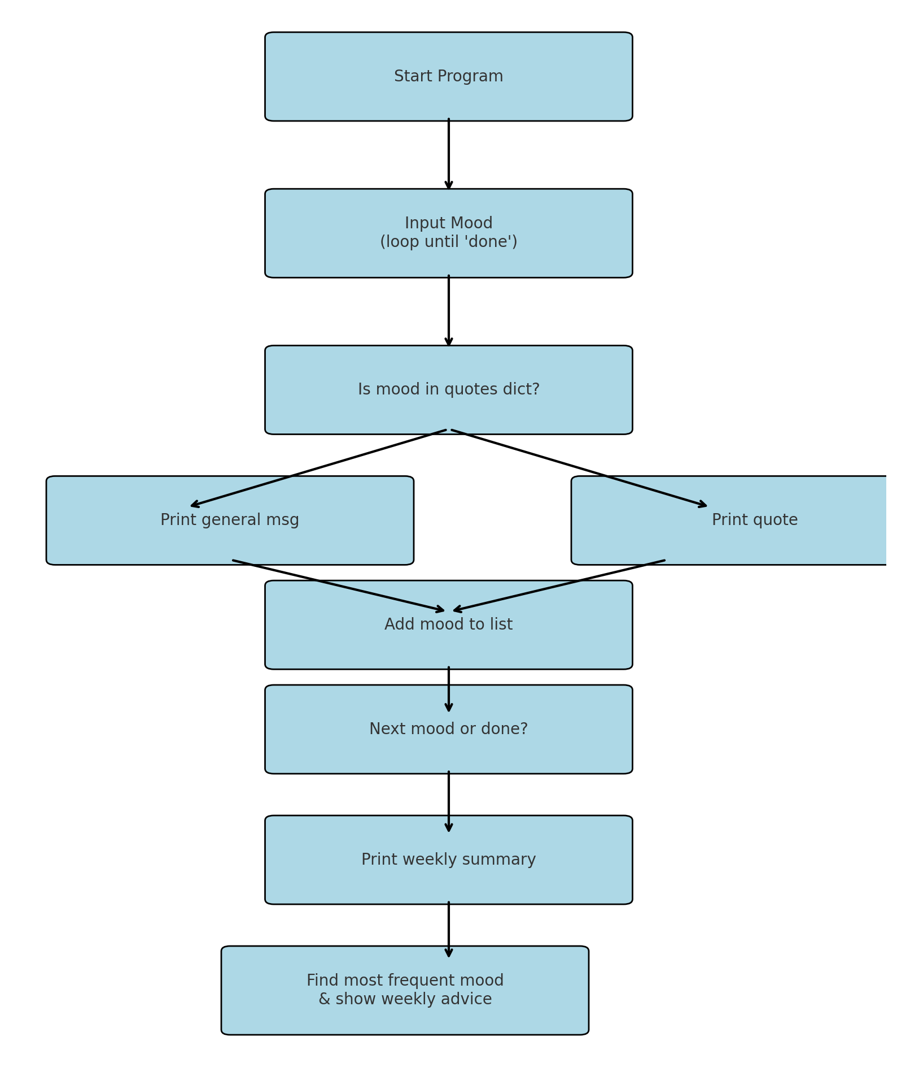
-Flow chart

Slide 8
-Results & Output
• Users input their mood each day.
• Motivational quote is displayed for known moods.
• Weekly summary includes:
- All logged moods
- Most frequent mood
- Weekly motivational advice
Example:
Day 1: Happy | Day 2: Sad | Day 3: Anxious
Most Frequent: Happy
Quote: Keep smiling! Your joy is contagious

Slide 9
-Conclusion
• Encourages daily emotional self-check-ins.
• Promotes positive thinking through quotes.
• Simple and extendable for future enhancements.
• Supports mental well-being and mindfulness.

Slide 10
Thank You…..!
Start your emotional wellness journey !

